Slide 1
COLOR THEORY

Slide 2
What is Color?
Color is a basic element of art that involves light. It is produced when light waves strike an object and are reflected into our eyes.
Importance of Colors?
Colour plays an important role in our lives. Colors can change moods, reduce or increase tensions, cause excitement, and sometimes have a soothing effect on a tired person.

Slide 3
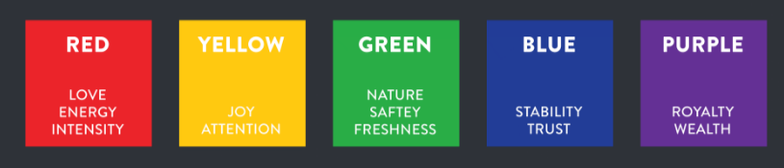
Color Associations

Slide 4
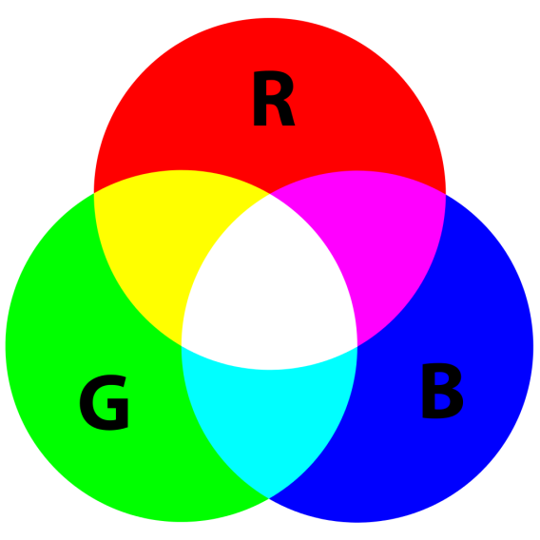
RGB Colors
RGB denotes (red, green and blue)
RGB refers to a system representing the colors used on a digital display screen. Red, green and blue can be combined in various proportions to obtain any color in the visible spectrum.
The RGB model uses 8 bits each for red, green and blue colors. Each color also has values ranging from 0 to 255. This translates into millions of colors.
16,777,216 possible colors to be precise.

Slide 5
HEX Code Colors
A hex code color is a hexadecimal way to represent a color in RGB format by combining three values the amounts of red, green and blue in a particular shade of color.
Hex color codes start with a pound sign or hashtag (#) and are followed by six letters and/or numbers. The first two letters/numbers refer to red, the next two refer to green, and the last two refer to blue. The color values are defined in values between 00 and FF (instead of from 0 to 255 in RGB).
Numbers are used when the value is 1-9. Letters are used when the value is higher than 9. For example:
A=10, B=11, C=12, D=13, E=14, F=15
To get a hexadecimal color, follow these three steps:
Multiply the first number by 16.
Multiply the second number by 1.
Add the two totals together.

Slide 6
HSL Colors
HSL stands for Hue, Saturation and Lightness
Hue is a degree on the color wheel from 0 to 360. 0 is red, 120 is green, and 240 is blue.
Saturation is a addition of gray color in any color. 0% is completely gray you can no longer see the color, 50% is 50% gray, but you can still see the color and 100% is pure color, no shades of gray.
Lightness is a addition of white color in any color. 0% Lightness shows the black color, 50% is the normal value for any color whereas 100% lightness show the white color.

Slide 7
HSLA Colors
HSLA colors are the abbreviation of Hue, Saturation and Lightness with Alpha(Opacity). This opacity is the transparency of the color.
The value of transparency ranges from 0 to 1.
0 is the transparent and 1 is opaque.
Brightness
Brightness refers to how much light appears to shine from something. This is a different perception than lightness, Brightness include the factor of shining whereas lighting doesn’t.
Contrast
contrast is the difference between dark and light colors or dark and light areas OR it is determined by the difference in the colour and brightness of the object and other objects within the same field of view.

Slide 8
FONTS THEORY

Slide 9
Fonts
Fonts are the styles for writing something these are the key part of every design. In fact, they are such an essential element that they can make any design look great or completely ruin a perfect design.
Fonts TypeFace
Font typeface is a general term which includes the font family follow with the name of font typeface.
There are different types of font TypeFace some of them are
Serif: Fonts that contain some extra portion at ends
Sans Serif: Fonts that do not contain some extra portion at end.
Script : These fonts are like traditional handwritting.

Slide 10
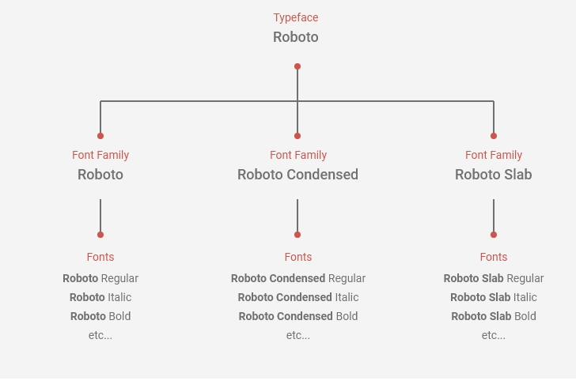
Fonts Family
Font Family is the submenu of font TypeFace which include fonts of different weight/styles i-e bold, italic, underline, black etc.

Slide 11
THANK YOU

